Slide 1
Computer Vision Fundamentals
Lecture 4 - Part 3
Image Restoration

Slide 2
Contents
Cleaning salt and pepper noise
Low pass filtering
Low pass filtering with median function
Cleaning gaussian noise
Image averaging
Average filtering

Slide 3
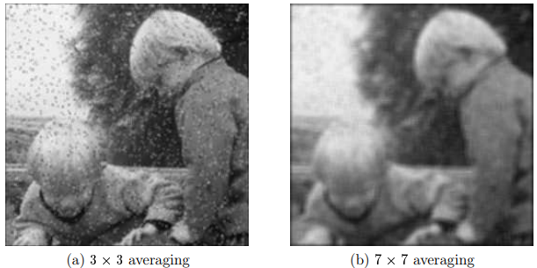
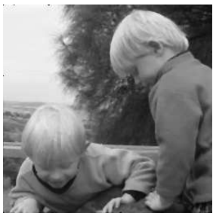
Cleaning salt and
pepper noise
Low pass filtering
Given that pixels corrupted by salt and pepper noise are high frequency components of an image, we should expect a low-pass filter should reduce them. So we might try filtering with an average filter: >> a3=fspecial(’average’);
>> t_sp_a3=filter2(a3,t_sp);
Cleaning it with a median function also reduces blurriness
>> t_sp_m3=medfilt2(t_sp);

Slide 4
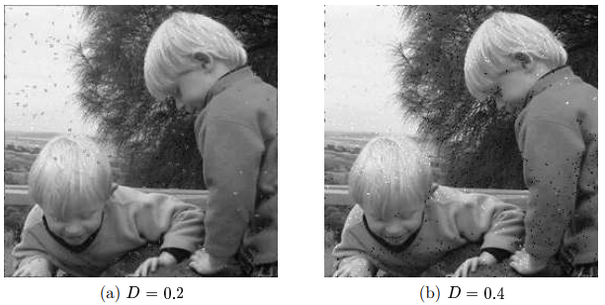
Cleaning Gaussian Noise
Image averaging
A case a very simple approach to cleaning Gaussian noise is to simply take the average—the mean—of all the image values

Slide 5
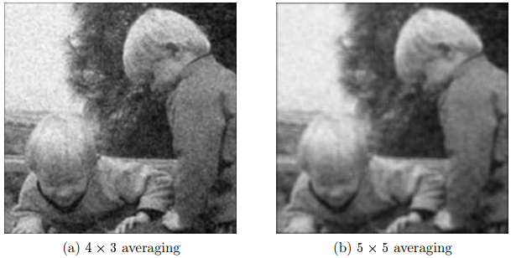
Cleaning Gaussian Noise
Average filtering
If the Gaussian noise has mean 0, then we would expect that an average filter would average the noise to 0. However, if we are prepared to trade off blurring for noise reduction, then we can reduce noise significantly by this method.

Slide 6
Thankyou

